Slide 1
Riley County Community Health Improvement
Planning Meeting
February 25, 2015

Slide 2
Welcome!

Slide 3
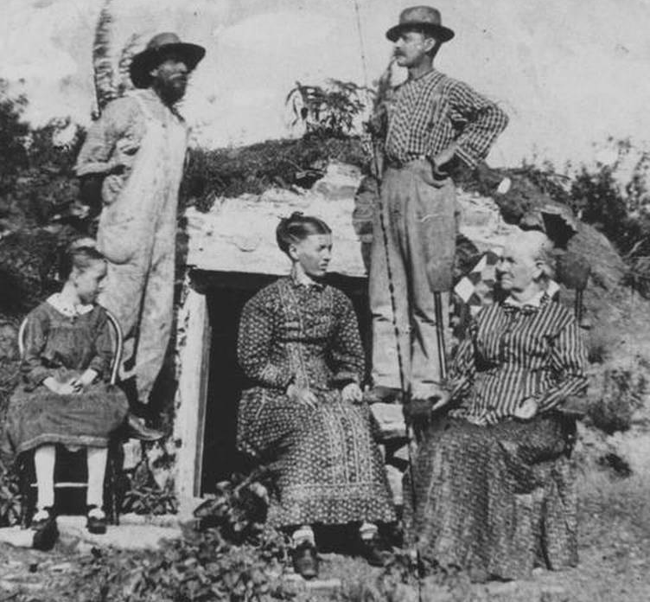
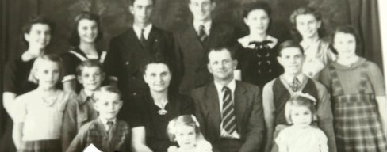
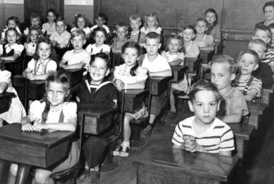
Can we Make a Difference in our Community’s Health?

Slide 4

Aligning Assessments Efforts
Multiple related efforts have been taking place over the past several months
Comprehensive Community Needs Assessment
Community Survey – over 1,000 respondents
Stakeholder Interviews
Focus Groups
Data Review
Local Public Health Systems Performance
Review of the Public Health System by Subject Matter Experts and Community Stakeholders
Community Health Improvement Plan
Determining top health priorities to address and improve through coordinated efforts in the next 3-5 years.
Many community partners have been involved

Slide 5

Comprehensive Community Needs Assessment
Key Partners
Project coordination provided by
Riley County
Seniors’ Service Center
Funding provided by:
Caroline F. Peine Charitable Foundation (Manhattan Fund)
Konza United Way
Mercy Regional Health Center
Riley County Council on Aging
Wamego Health Center
Conducted by Center for Community Support & Research
Wichita State University
Design Team Members:
Konza United Way
Mercy Regional Health Center
Riley County Health Department
Riley County Seniors’ Service Center
For full report, see www.rileycountycommunityneedsassessment.org

Slide 6
Community Meetings for Public Input
Please help publicize and consider attending!
✓ Thursday, January 29
Manhattan – Community Leader Meeting
✓Sunday, February 8
Manhattan
2-3:30pm
➔ Wednesday, Feb. 25
Keats
7:30-8:30pm
TBD
Spanish-speaking
✓ Thursday, February 12
Manhattan
1-2:30pm
Sunday, March 1
Leonardville
2:00-3:30pm
April 9
First United Methodist Church
Manhattan
3:00-5:00pm
Next steps – all are welcome!
✓ Wednesday, February 18
Riley
6:30-8:00pm
Monday, March 2
Randolph
12:00-1:00pm
✓ Tuesday, February 24
Ogden
6-7:30pm
Wednesday, March 4
Randolph
7:00-8:00pm

Slide 7


Two Types of Data Presented Today – Both are valuable!
Perception (what we think is true or most important about our community)
  Comprehensive Community Needs Assessment (CCNA) survey results
  Local Public Health Systems Assessment scoring and comment results
Representative Data (what is true or representative of our community)
  CCNA – included data from other sources
  Census (e.g., populations, income, poverty)
  Health vital statistics (e.g., birth and death data)
  Behavioral Risk Factor Surveillance System survey – self-reported health risk data (e.g., diagnosed with high blood pressure, eat fruits and veggies)
  Other sources
Sometimes the same

Slide 8
Participant Worksheet Instructions
Actively listen and take notes!

Slide 9

Demographic Overview
- Population Distribution

Slide 10
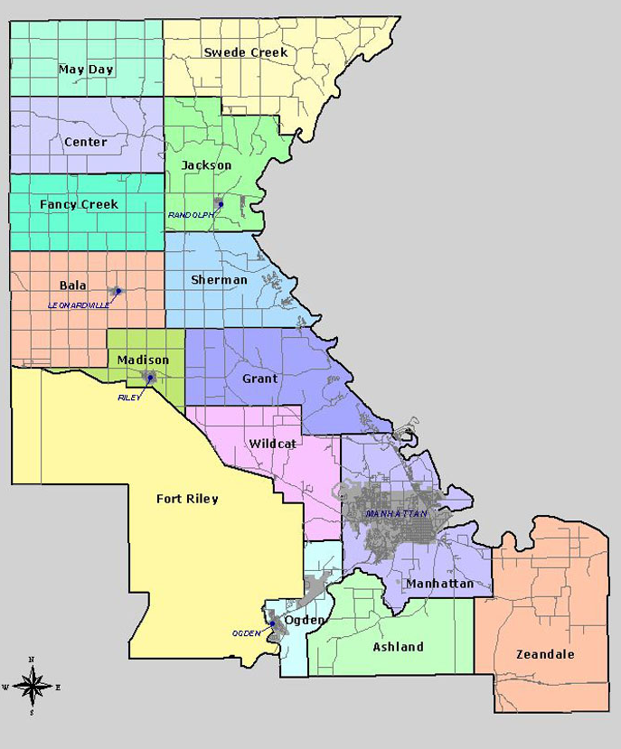
Notes:
2011-2013
Riley Co: 74,893
Manhattan: 55,483

Slide 11
* 2009 – 2013 ACS Census Estimates

Slide 12
* 2009 – 2013 ACS Census Estimates

Slide 13
* 2009 – 2013 ACS Census Estimates

Slide 14
Socioeconomic Overview
- Income
- Education

Slide 15
* 2009 – 2013 ACS Census Estimates

Slide 16
* 2009 – 2013 ACS Census Estimates

Slide 17
* 2009 – 2013 ACS Census Estimates

Slide 18
* 2009 – 2013 ACS Census Estimates
Notes:
1 person – about $12,000
2 people – about $16,000
Family of 4 with 2 adults and 2 children < 18 – about $24,000

Slide 19
* 2011 – 2013 ACS Census Estimates

Slide 20
* 2009 – 2013 ACS Census Estimates

Slide 21
Riley County Comprehensive Community Needs Assessment (CCNA)
Overview

Slide 22



“The overarching theme of the data collected is that Riley County is a community that is divided between a high quality of life, prosperity, and growth on one hand, and dwindling resources for and lack of attention to those who are most in need on the other.”
22

Slide 23
Overview of CCNA Findings
High quality of life
Growth
Spirit of community and collaboration
“Invisible” population with significant needs
Lack of accessible and affordable mental health services
Lack of affordable housing
Lack of accessible and affordable child care

Slide 24
Quality of Life
Riley County Comprehensive Community Needs Assessment

Slide 25

Quality of Life Findings
Percent respondents who “agree” or “strongly agree”
88% There are opportunities to volunteer in my community
87% This is a safe place to live
86% This is a good place to raise children
85% This is a beautiful place to live
82% I am satisfied with the quality of life in this community
41% I am satisfied with local government
39% All residents think that they can make the community a better place to live

Slide 26
Quality of Life: High-Low Game
Which did respondents score most important? (The rest were least important.)
Resources for Parents
Good schools
Low disease rates
Low level child abuse
Low disease rates

Slide 27






Most Important Factors that Contribute to Quality of Life
Percent respondents who selected these among their top three:
33% Good schools
30% Good place to raise children
25% Clean environment
24% Safe neighborhoods
19% Healthy economy
18% Low crime

Slide 28
Physical Health
Riley County Comprehensive Community Needs Assessment

Slide 29
Physical Health: High-Low Game
Which did respondents score, on average, as highest and lowest physical health needs?
Maternal health services
Prevention of infant mortality
Affordable health services
Tobacco cessation (quitting) services

Slide 30





Top three needs related to physical health in your community?
Percent respondents who selected these among their top three:
34% Affordable health services
30% Affordable health insurance
29% Facilities for physical activity (including parks, trails, rec centers)
22% Increased health education/prevention
19% Affordable prescriptions
17% Access to healthy food options

Slide 31
Health Data from Secondary Sources (2013 data, unless otherwise indicated) | Kansas | Riley County
Percent adults with fair or poor self- perceived health status | 15.4% | 8.7%
Percent population without health insurance | 12.3% | 6.2%
Percent adults with hypertension | 31.3% | 18.9%
Percent adults tested and diagnosed with high cholesterol | 38.1% | 28.6%
Percent adults diagnosed with diabetes | 9.6% | 4.5%
Rate of age-adjusted cancer (all cancers, per 100,000, 2007-2011) | 21.1 | 15.5

Slide 32
Health Data from Secondary Sources (2013 data, unless otherwise indicated) | Kansas | Riley County
Percent adults who are obese | 30.0% | 20.7%
Percent adults living with a disability | 21.1% | 15.5%
Percent adults not participating in the recommended level of physical activity (aerobic and/or strengthening) | 82.1% | 73.4%
Percent adults reported consuming fruit less than one time per day | 41.7% | 44.6%
Percent adults consuming vegetables less than one time per day | 22.9% | 27.3%
Percent adults who currently smoke cigarettes | 20.0% | 19.8%

Slide 33
Mental Health
Riley County Comprehensive Community Needs Assessment

Slide 34
Mental Health: High-Low Game
Which did respondents score as the highest need? (Other two scored lowest compared to all choices given.)
Affordable mental health services
Availability of transportation services for mental health
Affordable prescriptions

Slide 35



Top three needs related to mental health in your community?
Percent respondents who selected these among their top three:
40% Affordable mental health services
36% Affordable health insurance that includes mental health
32% High quality mental health services
28% Increased mental health education/prevention
27% Increased number of mental health providers

Slide 36
Data from Secondary Sources (2013 data, unless otherwise indicated) | Kansas | Riley County
Percent of adults reporting that mental health was not good on 14 or more days in the past 30 days | 9.7% | 9.8%
Percent of adults ever diagnosed with a depressive disorder | 18.1% | 23.9%

Slide 37
Social Issues
Riley County Comprehensive Community Needs Assessment

Slide 38
Social Issues: High-Low Game
Which did respondents score as the highest issue of concern?
Youth/gang violence
Elder abuse
Teen pregnancy
Inattentive driving

Slide 39

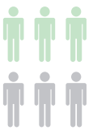

Top three social issues that are of most concern in your community?
Percent respondents who selected these among their top three:
27% Inattentive driving
27% Drinking and driving
26% Poverty
24% Youth drug or alcohol use
19% Mental illness
18% Adult drug or alcohol use

Slide 40

Top three needs related to social issues in your community?
Percent respondents who selected these among their top three:
34% Availability of services for people with low incomes
26% Positive activities for youth
25% Availability of employment
22% Availability of mental health services
20% Child care

Slide 41
Data from Secondary Sources (2012 data, unless otherwise indicated) | Kansas | Riley County
Percent of persons with food insecurity | 15.0% | 16.2%
Percent of adults who are binge drinkers (2013) | 15.4% | 24.4%

Slide 42
Children and Youth
Riley County Comprehensive Community Needs Assessment

Slide 43
Children & Youth: High-Low Game
Which did respondents score as highest needs for children and youth?
Dental care
Transportation
Medical care

Slide 44



Top three needs related to children in your community?
Percent respondents who selected these among their top three:
23% Child care for children 0-5
23% Financial assistance to families (for nutrition, child care, housing, etc.)
22% After school programs
18% Parenting education/skills development
17% Recreational activities

Slide 45

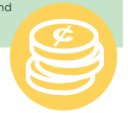
Top three needs related to youth in your community?
Percent respondents who selected these among their top three:
21% Employment opportunities for teens
18% Opportunities to contribute to the community
17% Financial skills training
15% Recreational activities
14% Bullying/relationship violence prevention
14% Appropriate internet/technology use

Slide 46
Data from Secondary Sources (2012 data, unless otherwise indicated) | Kansas | Riley County
Percent of births with inadequate prenatal care | 11.7% | 13.4%
Percent of premature births (2010 – 2012) | 8.9% | 8.1%
Infant mortality rate (2009 – 2013) | 6.4 | 6.2

Slide 47
Education
Riley County Comprehensive Community Needs Assessment

Slide 48
Education: High-Low Game
Which did respondents score as highest need?
Raising standardized test scores
Updated text books
Condition of school buildings
Getting & keeping good teachers
More extracurricular activities

Slide 49

Top three needs regarding education in your community?
Percent respondents who selected these among their top three:
35% Getting and keeping good teachers
18% Increased parental involvement
16% Increased expectations for student achievement
16% Equality in funding among school districts
In general, respondents rated the quality of schools and teachers very high.

Slide 50
Aging
Riley County Comprehensive Community Needs Assessment

Slide 51
Aging: High-Low Game
Which did respondents score as the highest need?
Elder abuse
Affordable housing
Substance abuse
Hospice
Utility assistance

Slide 52


Top three needs for older adults in your community?
Percent respondents who selected these among their top three:
22% Affordable housing
19% Independent living at home
16% Transportation
13% Ease of mobility in the community
13% Affordable prescriptions

Slide 53
Housing
Riley County Comprehensive Community Needs Assessment

Slide 54
Housing: High-Low Game
Which did respondents score as the highest need?
Affordable housing options
Historic preservation
Education about responsible homeownership

Slide 55



Top three needs related to housing in your community?
Percent respondents who selected these among their top three:
52% Affordable housing
26% Assistance with property repair and maintenance
26% Higher quality rentals
24% Code enforcement
20% Neighborhood improvement programs

Slide 56
Transportation
Riley County Comprehensive Community Needs Assessment

Slide 57
Transportation: High-Low Game
Which did respondents score as the highest need?
Build new roads
Increase options for overnight public parking
Widen existing roads
Improve public transit service
Improve driver education

Slide 58

Top three transportation-related needs in your community?
Percent respondents who selected these among their top three:
40% Improve public transit service
32% Develop a pedestrian-friendly transportation system to make areas more walkable
31% Provide maintenance and improvements to existing facilities
28% Expand and improve the bike route system
26% Address texting and driving

Slide 59
Data from Secondary Sources (2013 data, unless otherwise indicated) | Kansas | Riley County
Percent adults who reported they do not always wear a seatbelt when they drive or ride in a car | 17.0% | 12.3%
Age-adjusted traffic injury mortality rate (2011-2013 per 100,000) | 13.3 | 10.0

Slide 60
Infrastructure
Riley County Comprehensive Community Needs Assessment

Slide 61




How would you rate the following public services/features?
Highest rated services:
Library facilities
Fire department
Emergency services
Air quality
Clean environment
Lower rated services (still averaged fair-good):
Paths/safe options for biking and walking
Code enforcement for private properties
Road maintenance

Slide 62
Economics and Personal Finance
Riley County Comprehensive Community Needs Assessment

Slide 63
Economics and Personal Finance: High-Low Game
Which did respondents score as the highest need?
Employment opportunities for youth
Employment opportunities for older adults
Access to education
Availability of jobs

Slide 64


Top three economic/personal finance needs in your community?
Percent respondents who selected these among their top three:
36% Availability of jobs
21% Emergency assistance to individuals or families
21% Assistance with searching for and gaining employment
20% Small business development
19% Low-cost resources to help with personal finance management

Slide 65
Review of Key Findings
Riley County Comprehensive Community Needs Assessment

Slide 66
“The overarching theme of the data collected is that Riley County is a community that is divided between a high quality of life, prosperity, and growth on one hand, and dwindling resources for and lack of attention to those who are most in need on the other.”
66

Slide 67
Overview of CCNA Findings
High quality of life
Growth
Spirit of community and collaboration
“Invisible” population with significant needs
Lack of accessible and affordable mental health services
Lack of affordable housing
Lack of accessible and affordable child care

Slide 68
Leading
Causes of
Death
Riley County Comprehensive Community Needs Assessment

Slide 69
Leading Causes of Death
(2009-2013)
Kansas
Cancer
Heart Disease
Chronic Lower Respiratory Diseases
Unintentional Injuries
Stroke
Alzheimer’s Disease
Diabetes
Pneumonia & Influenza
Kidney Disease
Suicide
Riley County
Cancer
Heart Disease
Stroke
Chronic Lower Respiratory Diseases
Unintentional Injuries
Pneumonia & Influenza
Alzheimer’s Disease
Diabetes
Kidney Disease
Suicide

Slide 70
Key Health Indicators
Riley County Comprehensive Community Needs Assessment

Slide 71
Comparison Areas
Largest city in each county?
Kansas
Riley
Geary
Pottawatomie
Douglas

Slide 72
Infant Mortality Rate
County with highest rate?

Slide 74
Percent of Births Where Mother Smoked During Pregnancy
County with highest rate?

Slide 79
Percentage of Adults who are Binge Drinkers
County with highest rate?

Slide 81
Percentage of Adults who Smoke Cigarettes
County with highest rate?

Slide 83
Percentage of Adults with no Personal Doctor or
Health Care Provider
County with highest/ lowest percentage?

Slide 85
Percentage of Adults with Consuming Fruit, Vegetables Less than 1 Time Per Day
County with highest/ lowest rate?

Slide 88
Local Public Health Systems Assessment

Slide 89
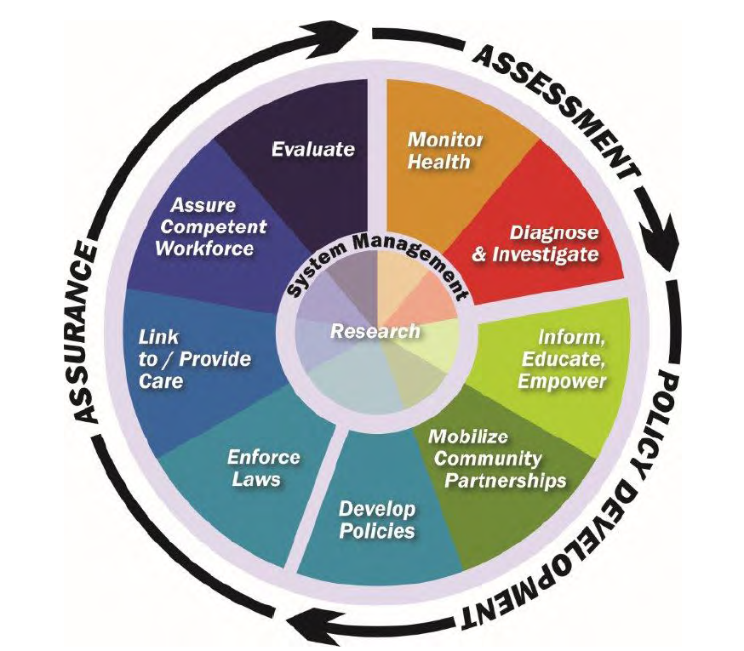
Local Public Health Systems Assessment (LPHSA)
What is public health? Activities that society undertakes to assure the conditions in which people can be healthy.
  The public health system is more than the public health agency…it involves all public and private entities that contribute to public health and the health and well-being of a community.
10 Essential Public Health Services provided the framework for the assessment instrument
10 services and related “model standards” describe an optimal level of performance and capacity
Approximately 100 people participated in the assessment in June 2014
See report for detailed description of scoring instrument, process, and results

Slide 90
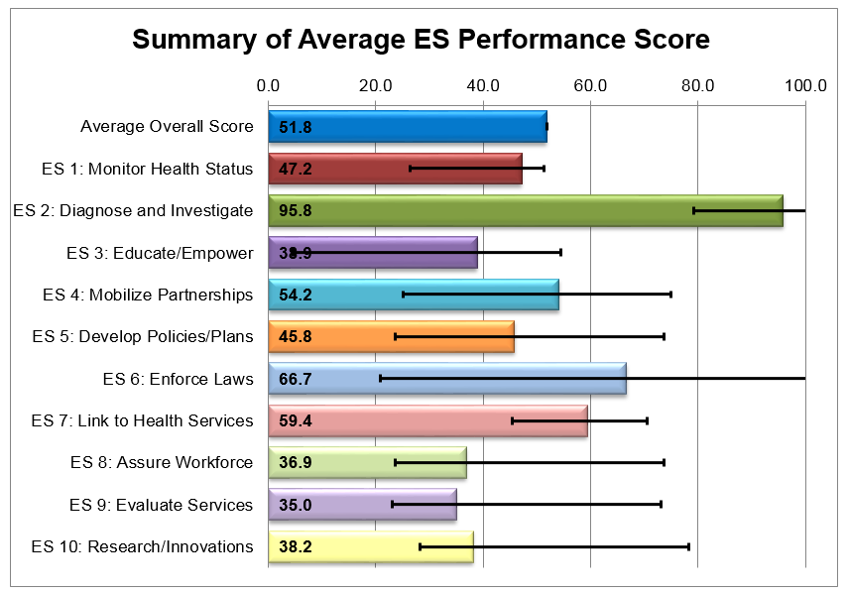
Local Public Health System Assessment (LPHSA) Results
Overall, the Riley County Public Health System scored very favorably
No essential services performed in the “No Activity” (0%) or “Minimal Activity” (1-25%) range.

Slide 91

Overall Local Public Health Systems Assessment Observations
In general, public health system scored well on the tool with room for improvements.
Much work is being done (lots of resources, lots of organizations, doing a lot of good things)…but many (including community leaders, providers, organizations, and the public) don’t know about it
Some essential services are lacking a central authority or lead organization to take fully implement or utilize resources in an intentional, coordinated way
Need for increased communication, coordination, and linkages within the local public health system
Need to expand local public health system’s ability to share and use data and informational resources
General lack of awareness the public health system
Concerns related to mental health
Concerns related to Northern Riley County (rural areas in general)

Slide 92
Facilitated
Group Discussion:
In your opinion, what are the top health needs that must be addressed in the next 3-5 years?

Slide 93
Large Group Voting –
Distribute your dots (votes) in any way you choose

Slide 94
Resources
Riley County Community Health Improvement Planning process and meetings:
datacounts.net/rcchip/
Riley County Comprehensive Community Needs Assessment Results:
www.rileycountycommunityneedsassessment.org
Riley County Local Public Health System Assessment Results:
datacounts.net/lphsa/

Slide 95
Thank you!

Slide 96
Extra Slides

Slide 97
Welcome from
Mercy Regional Health Center and
Riley County Health Department

Slide 98
Value of Health Planning Process and Community Input
Mercy Regional Health Center
Mercy has a long history of conducting community health needs assessments in order to identify priority health needs and adopt related implementation strategies to address those needs of those we serve. These assessments help us understand our patients.
Community meetings provide the opportunity for citizens to communicate directly with local public health agencies, health and social service organizations, and other community stakeholders to accelerate community health improvement.
A large component of the mission of Mercy is to “serve as a healing presence with special concern for our neighbors who are vulnerable.” We are grateful to collaborate with local agencies in order to better serve the needs of this community and embrace the social responsibility to those in need.

Slide 99
Value of Health Planning Process and Community Input
Riley County Health Department
  Today’s meeting and upcoming public meetings provide an opportunity for us to review the assessment results collected the last year and, as a community, identify and prioritize our most important health needs
  The Department uses the Public Health Accreditation Board’s standards and measures as the framework for quality public health services. This voluntary national accreditation program requires a community health assessment, a community health improvement plan, and an agency strategic plan to guide our work

Slide 100
Aligning Assessments Efforts
Multiple related efforts have been taking place over the past several months
Comprehensive Community Needs Assessment
April 2014 – November 2014
Planning Committee
Riley County Senior Services Center*
Local Public Health Systems Performance
November 2013 – August 2014
Planning Committee
Riley County Board of Health
Riley County Health Department
Envisage Consulting, Inc.*
Community Partners
*Funding approved by the Riley County Board of Health
Community Health Improvement Plan
October 2014 – April 2015
Planning Committee
Riley County Health Department*
Mercy Regional Health Center
Riley County Seniors’ Service Center
Konza United Way
First United Methodist Church
Community Partners
*Funding approved by the Riley County Board of Health
**Funding for this project provided by a grant from the Kansas Health Institute (Accreditation Readiness Mini-Grant)
**A project made possible with funding from the Caroline Peine Foundation Charitable Foundation (Manhattan Fund) and the above.
*Coordinated by RCSSC in cooperation with the Center for Community Support & Research, Wichita State University.
Riley County Health Department
United Way of Riley County**
And more than 50 community partners
Riley County Council on Aging**
Mercy Regional Health Center**

Slide 101
Comprehensive Community Needs Assessment
Purpose
Gather data and community input regarding 11 areas of interest related to quality of life in Riley County.
General Quality of Life
Physical Health (including physical activity, nutrition and tobacco use)
Mental Health
Social Issues
Children and Youth
Education
Aging
Housing
Transportation
Infrastructure
Economics and Personal Finance

Slide 102
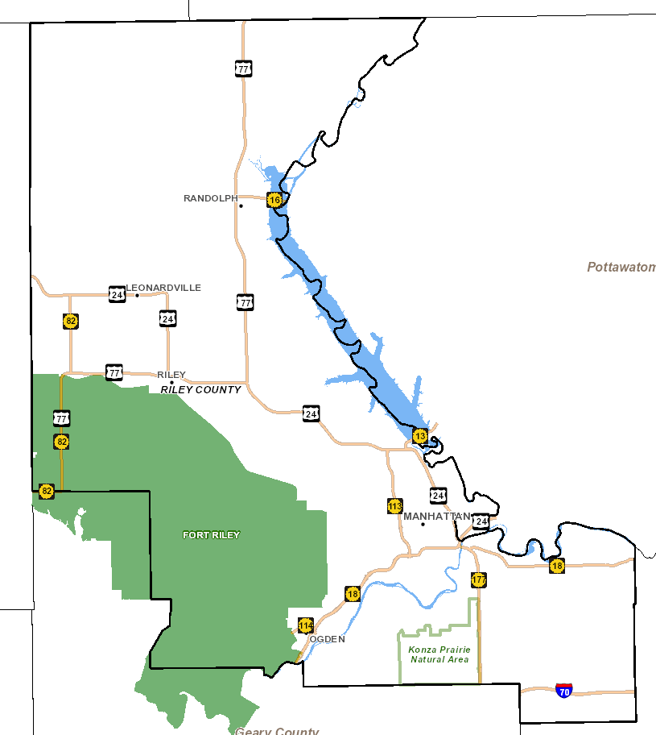
Notes:
2011-2013
Riley Co: 74,893
Manhattan: 55,483

Slide 109
Percent Obese
County with lowest rate?

